Slide 1
Main font:
The fountains of wishes

Slide 2




Slide 3

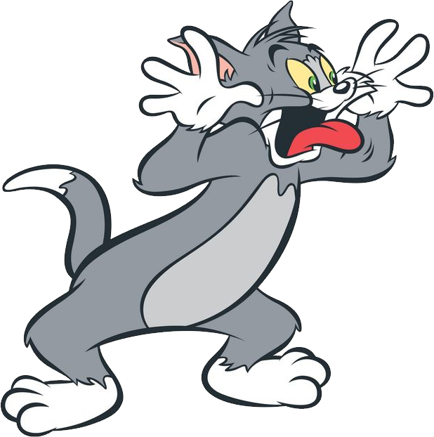
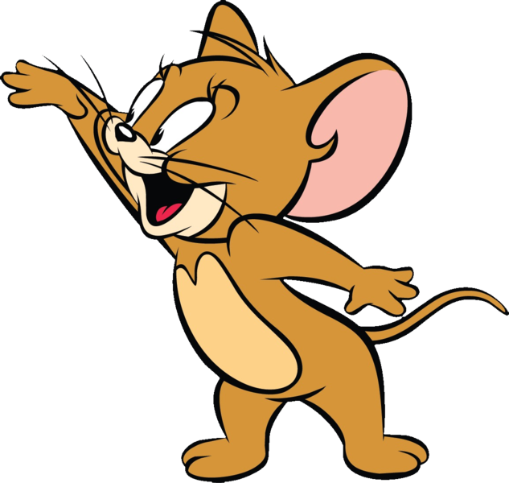


Slide 4
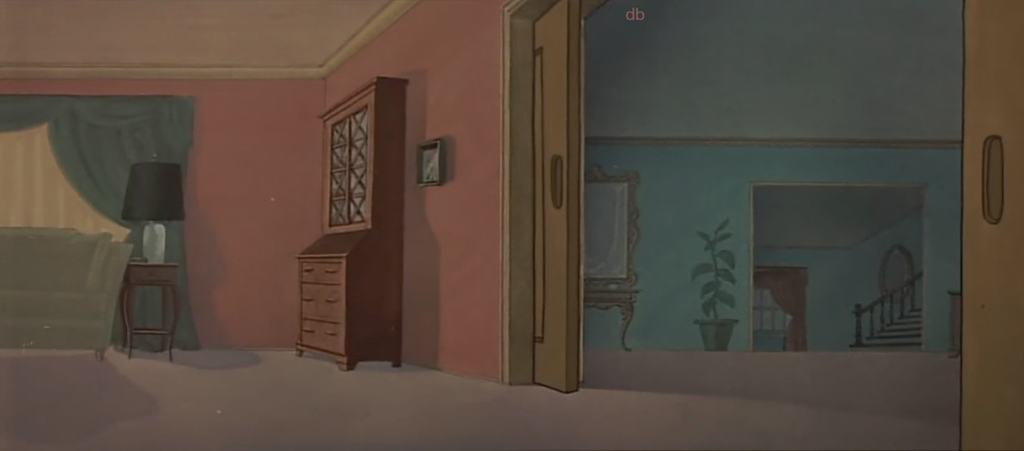
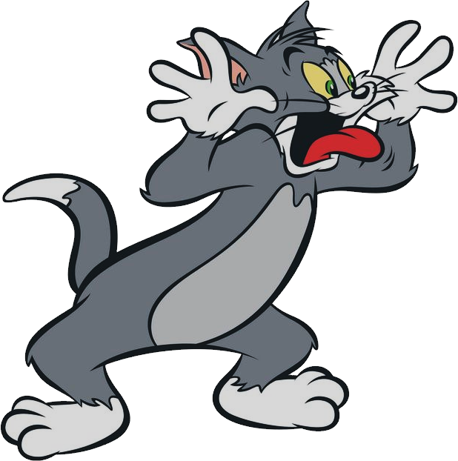
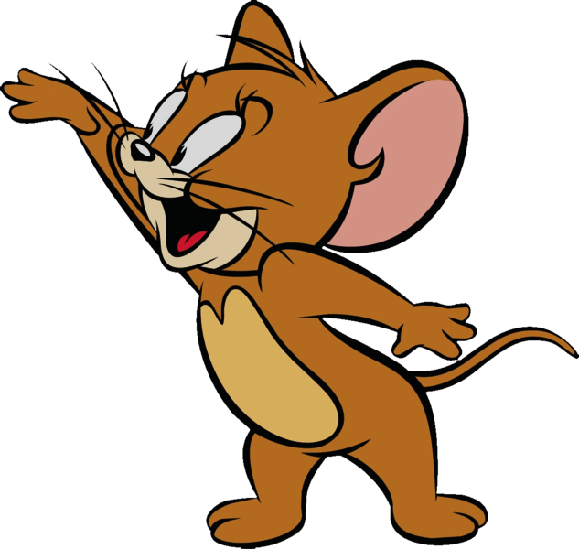

Mouse Maze

Slide 5

Name
Steps
Time
Name
Steps
Time
Easy
Easy
1 USERNAME_1 100 10:30
1 USERNAME_1 100 10:30
Medium
Medium
Hard
Hard

Slide 6
Name
Steps
Time
Easy
1 USERNAME_1 100 10:30
Medium
Hard

Slide 7
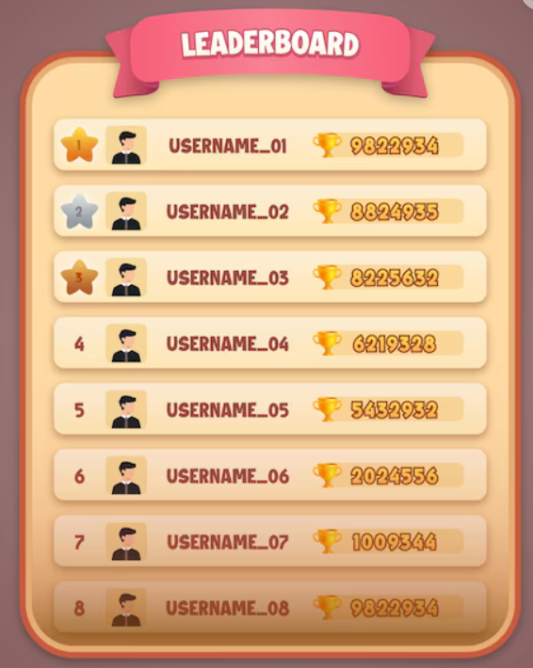
Name
Steps
Time
Easy
1 USERNAME_1 100 10:30
Medium
Hard

Slide 8
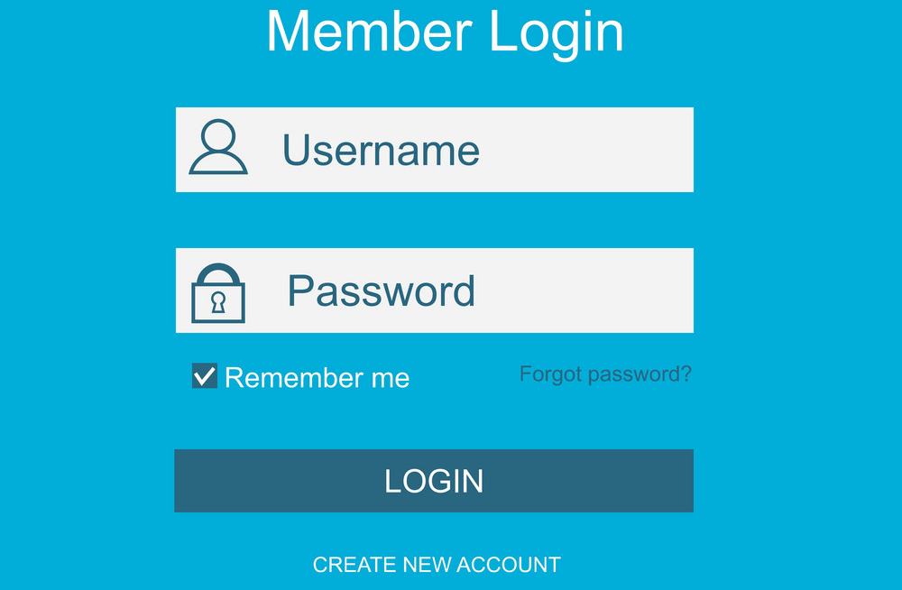


Your score won’t be saved if you don’t log in
Would you like to log in?
Log In
Sign In
Log In
Sign In

Slide 9
Log In
Sign In

Slide 10
Your score won’t be saved if you don’t log in
Would you like to log in?

Slide 11
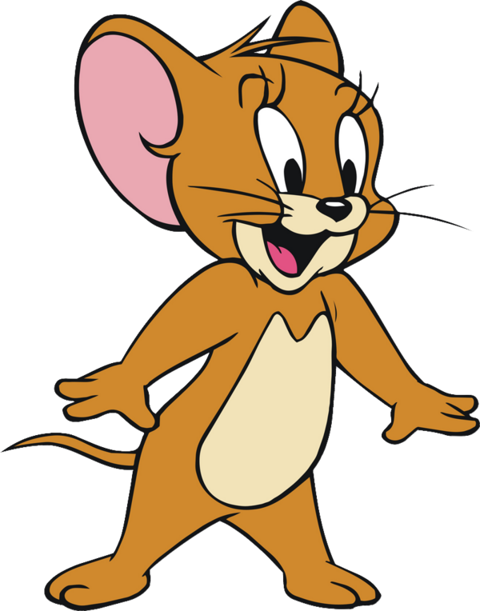
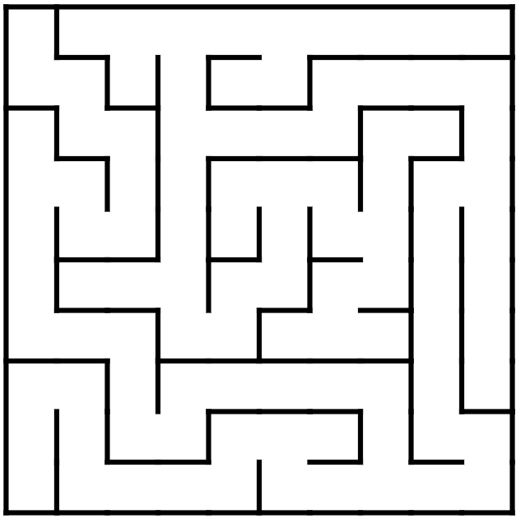

Choose Difficulty

Slide 12
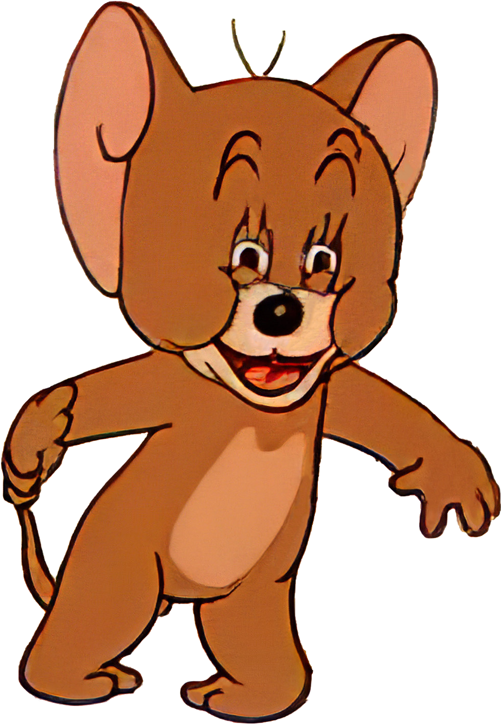
Choose Difficulty

Slide 13
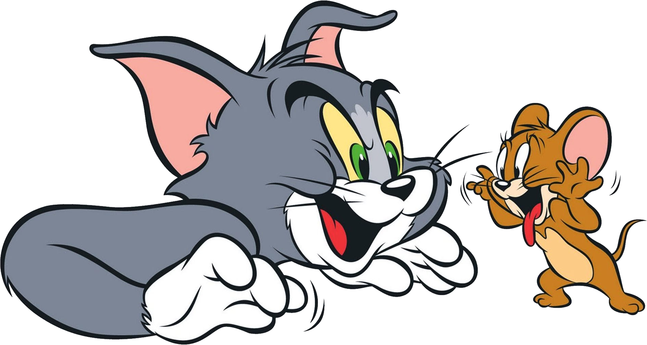
Choose Difficulty

Slide 14
Load Game

